Slide 1
Part 8: Convolution Neural Network
Presented By: T.E. Shree Ram Khaitu

Slide 2
Content
CNN Basics
1D,2D,3D Convolution Nets

Slide 3



Why CNN?

Slide 4
2
4
8
10
29
9
3
1
11
12
16
90
53
6
80
17
2 | 4 | 8 | 10
29 | 9 | 3 | 1
11 | 12 | 16 | 90
53 | 6 | 80 | 17

Slide 5
More parameter
64*64*3
12288*1
20 units
40 units
1 units

Slide 6
Not Translation Invariance
`
S
S

Slide 7


Slide 8
Convolution/Correlation
7 | 1 | 2 | 8
3 | 5 | 4 | 4
6 | 12 | 10 | 7
11 | 9 | 2 | 3
-1 | 0
0 | 1

Slide 9
padding

Slide 10
Stride
7 | 1 | 2 | 8
3 | 5 | 4 | 4
6 | 12 | 10 | 7
11 | 9 | 2 | 3
-1 | 0
0 | 1

Slide 11
7 | 1 | 2 | 8
3 | 5 | 4 | 4
6 | 12 | 10 | 7
11 | 9 | 2 | 3
7 | 1 | 2 | 8
3 | 5 | 4 | 4
6 | 12 | 10 | 7
11 | 9 | 2 | 3
7 | 1 | 2 | 8
3 | 5 | 4 | 4
6 | 12 | 10 | 7
11 | 9 | 2 | 3
-1 | 0
0 | 1
-1 | 0
0 | 1
-1 | 0
0 | 1

Slide 13
Input(shape=(28, 28, 1), name="img")
x = layers.Conv2D(16, 3, activation="relu")
x = layers.Conv2D(32, 3, activation="relu")(x) x =
x = layers.Conv2D(32, 3, activation="relu")(x)
x = layers.Conv2D(16, 3, activation="relu")(x)
x = layers.Conv2D(16, 3, activation="relu")(x)
x = layers.Conv2D (32, 3, activation="relu")(x
x = layers.Conv2DT(16, 3, activation="relu")(x)
X=flatten()
x = layers.dense(64, activation="relu")(x)
X=layers.dense(10,activation=‘softmax)’

Slide 14
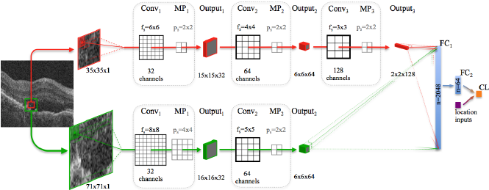

Slide 15
Pooling
Max
average
7 | 1 | 2 | 8
3 | 5 | 4 | 4
6 | 12 | 10 | 7
11 | 9 | 2 | 3

Slide 16

pool

Slide 17
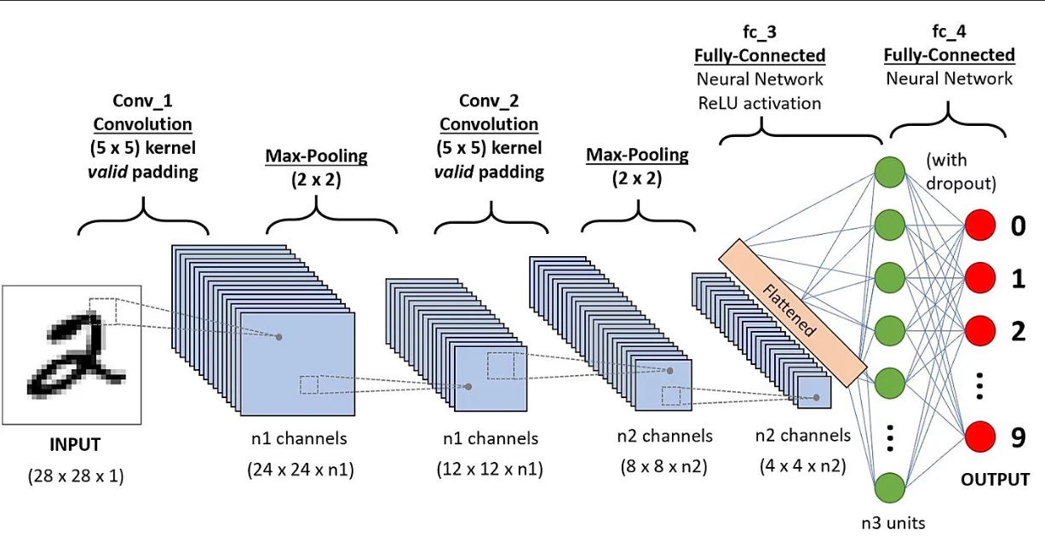

Slide 18


Slide 19
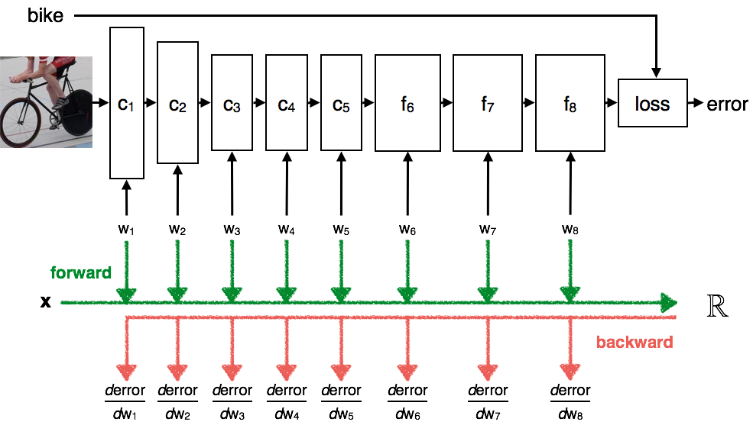

Slide 22
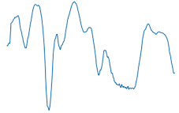
1D CNN
Slides along One dimension

Slide 23
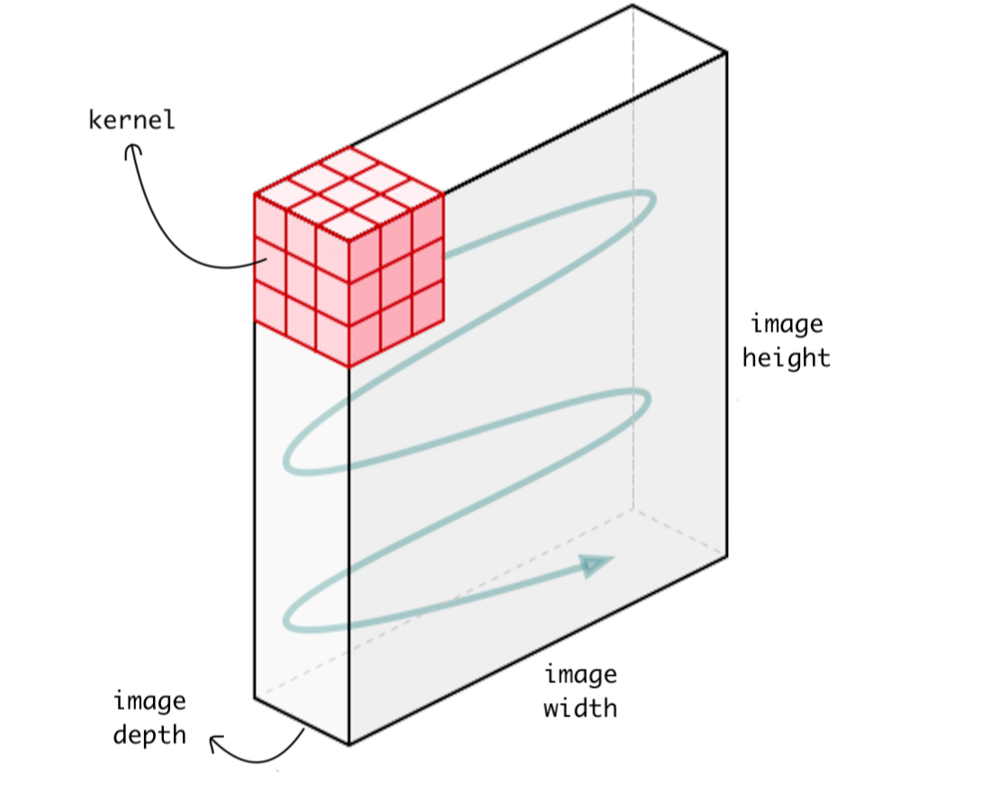
2D CNN
Lenet arch
Image data
Slides along 2 dimensions

Slide 24
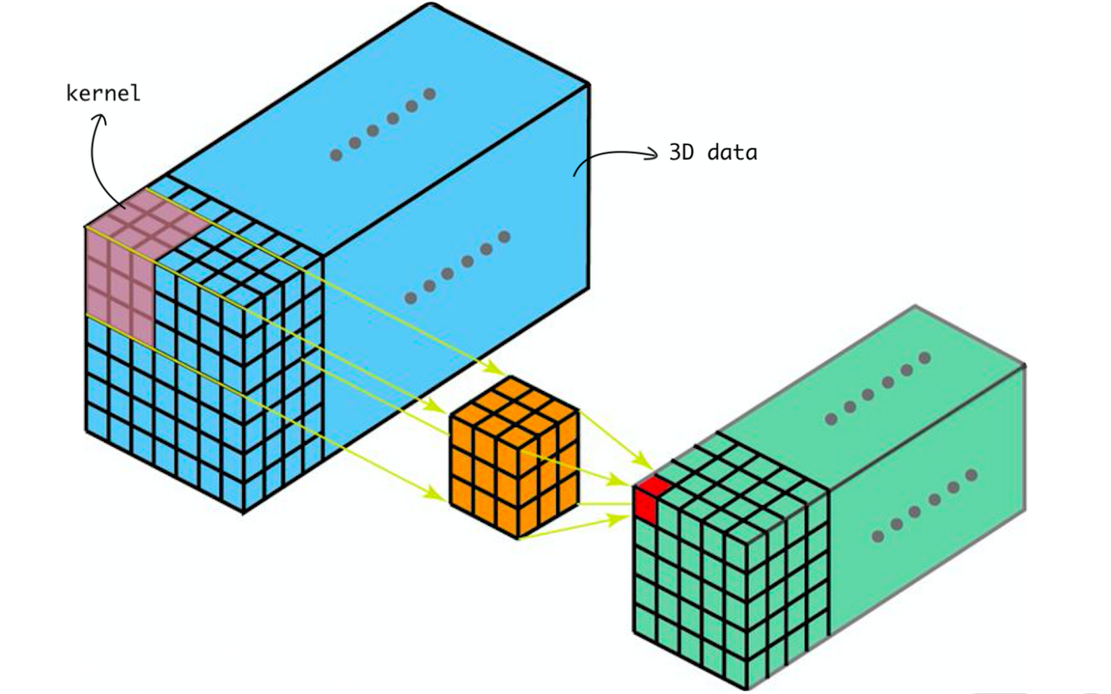
3D CNN

